Slide 1

Creating a Killer Landing Scenario
Luxury Homebuilder
October 2015

Slide 2
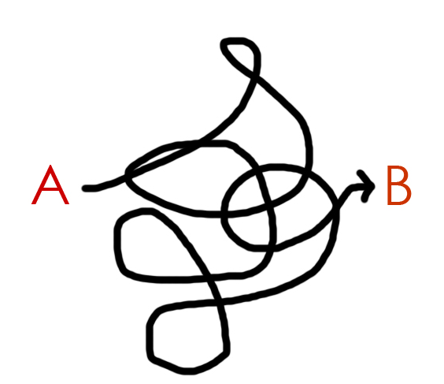
Creating a Killer Landing Scenario
How to Get From Point “A” to Point “B”

Slide 3
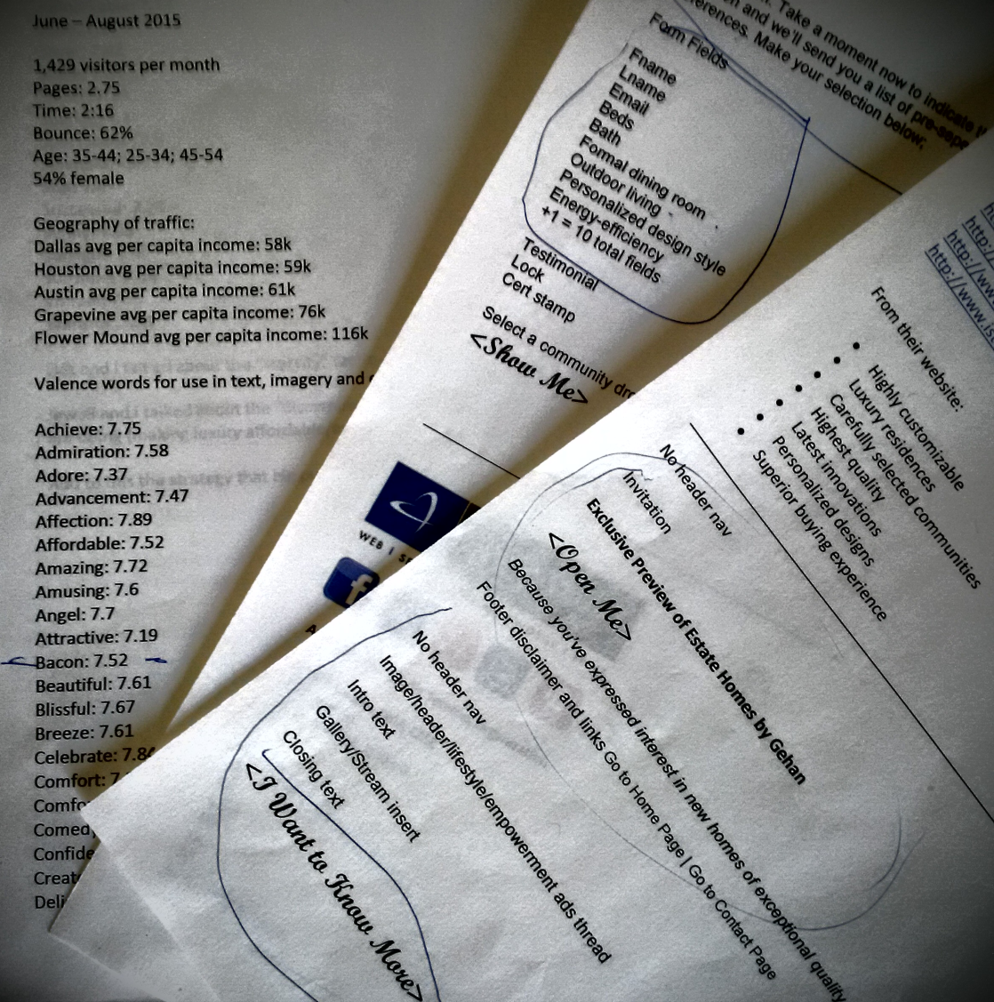
Creating a Killer Landing Scenario
Define the Storyline, Concept and Social Intel Pathway

Slide 4
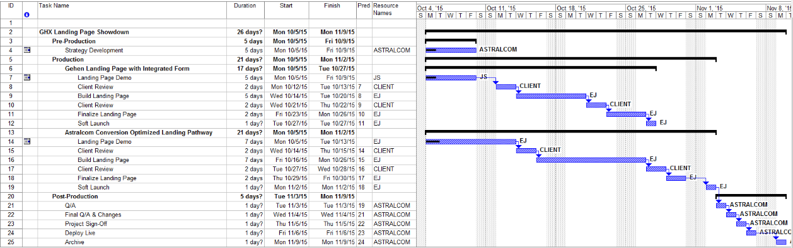
Creating a Killer Landing Scenario
Develop a Project Timeline

Slide 5

Creating a Killer Landing Scenario
Concept the Design Idea

Slide 6


Creating a Killer Landing Scenario
Develop the Storyline

Slide 7

Creating a Killer Landing Scenario
Deliver the Final: The Invitation

Slide 8

Creating a Killer Landing Scenario
Deliver the Final: Ask the Question

Slide 9

Creating a Killer Landing Scenario
Deliver the Final: Set the Stage

Slide 10

Creating a Killer Landing Scenario
Deliver the Final: Create Inspiration

Slide 11

Creating a Killer Landing Scenario
Deliver the Final: Answer the Question

Slide 12
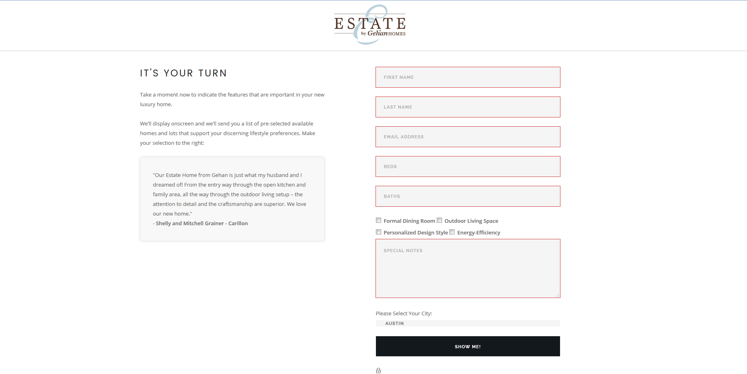
Creating a Killer Landing Scenario
Deliver the Final: Call-to-Action

Slide 13

Creating a Killer Landing Scenario
800.536.6637 | astralcom.com/homebuilders

Slide 14
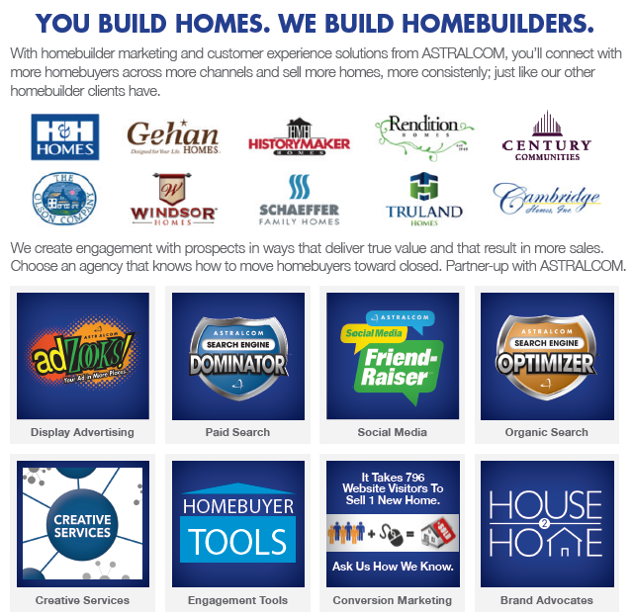
Creating a Killer Landing Scenario
800.536.6637 | astralcom.com/homebuilders

